Slide 1
Design Chat System Adds-on

Slide 2
Grokking (Facebook Messenger)
Pull vs Push
Online/Offline
Sequencing of messages
Storage Type
Partitioning

Slide 3
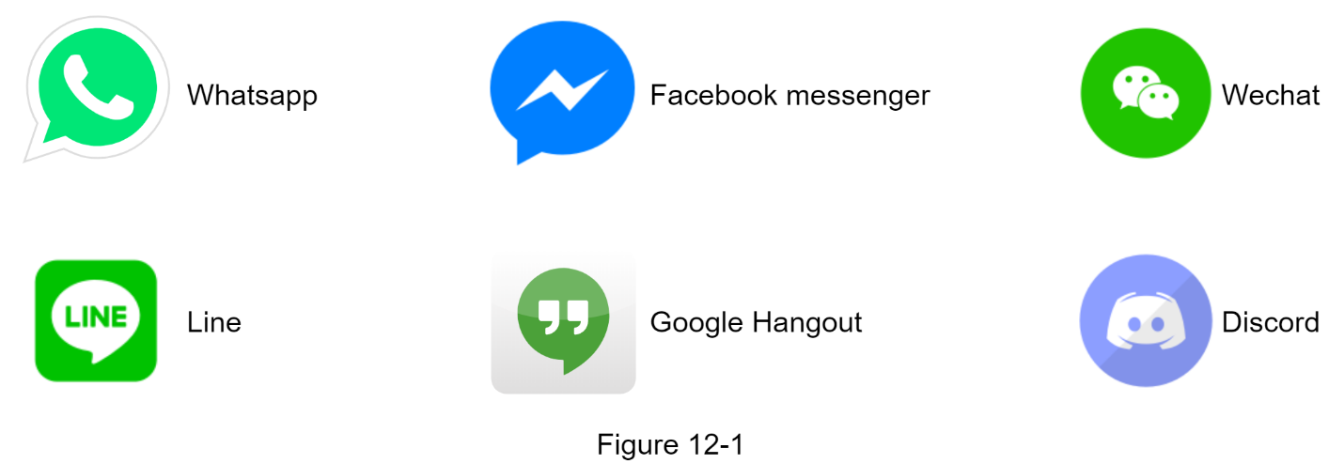

Slide 4
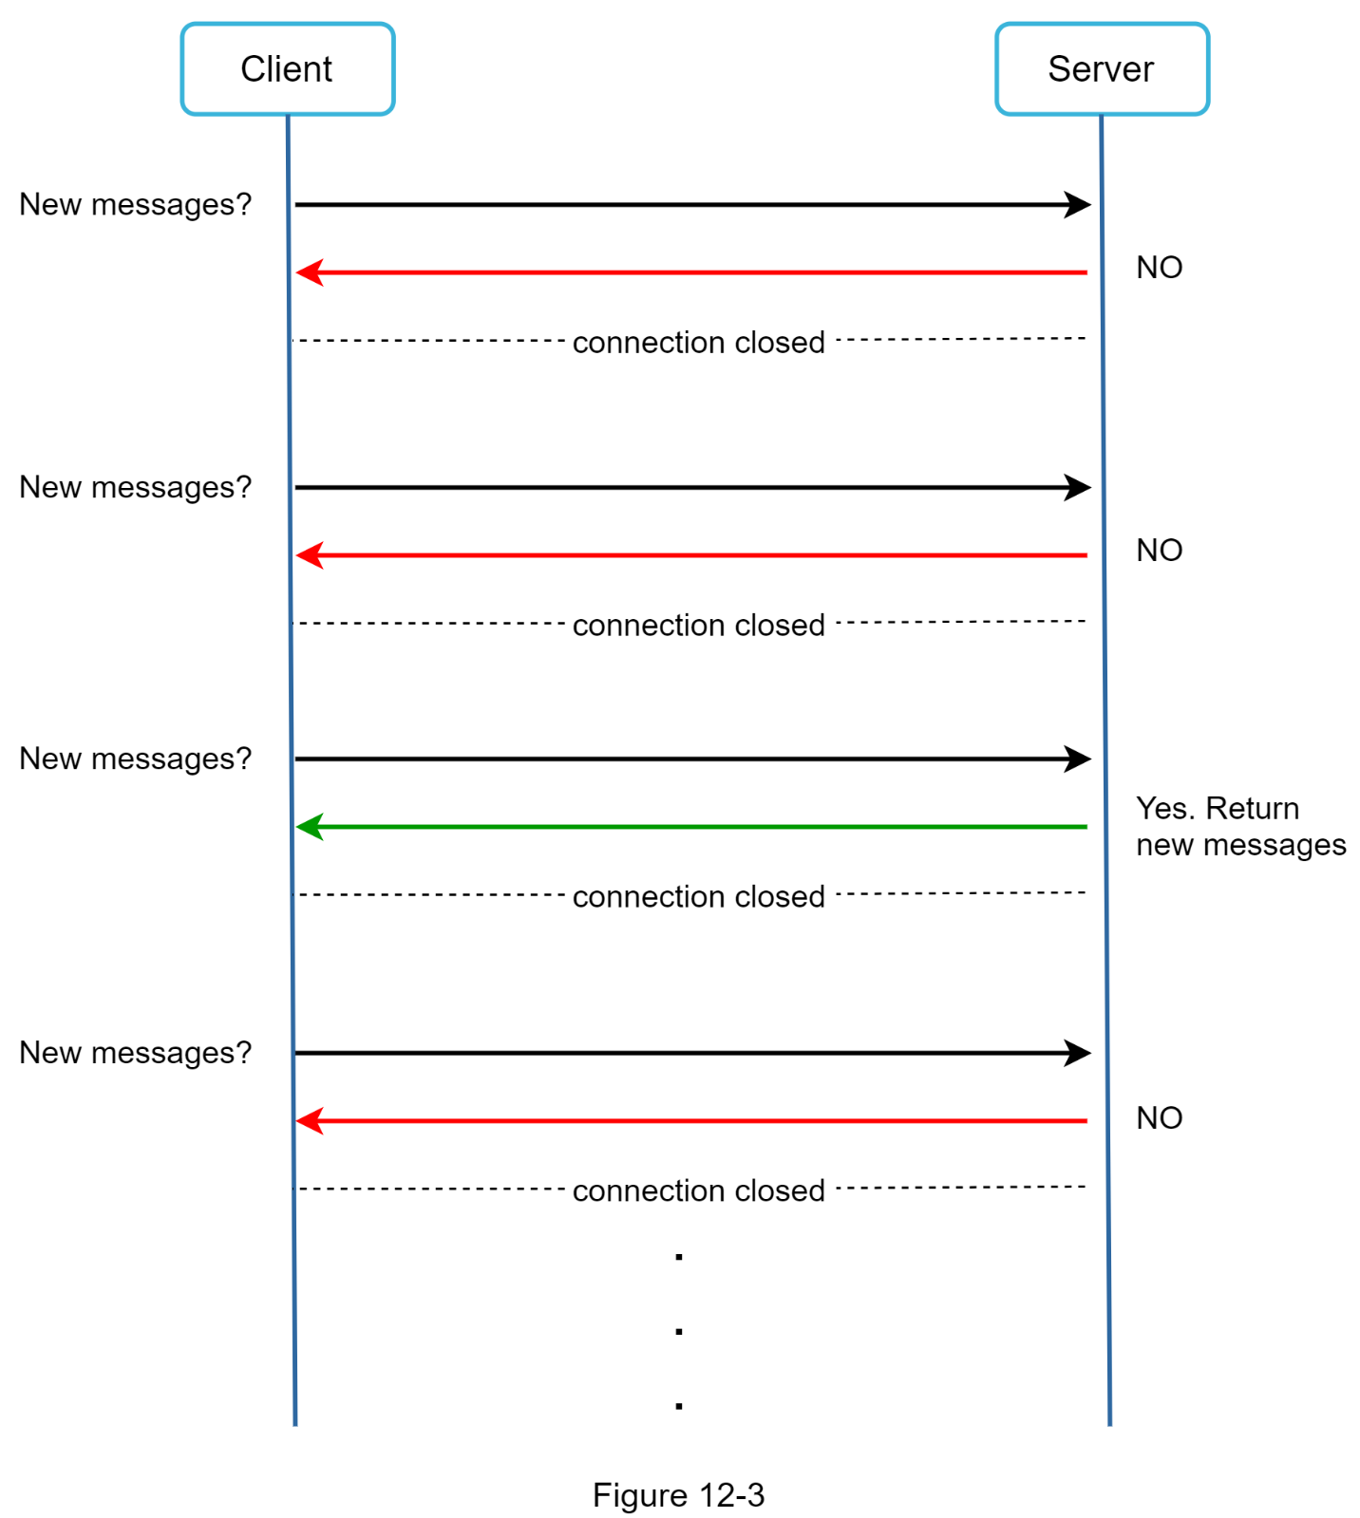
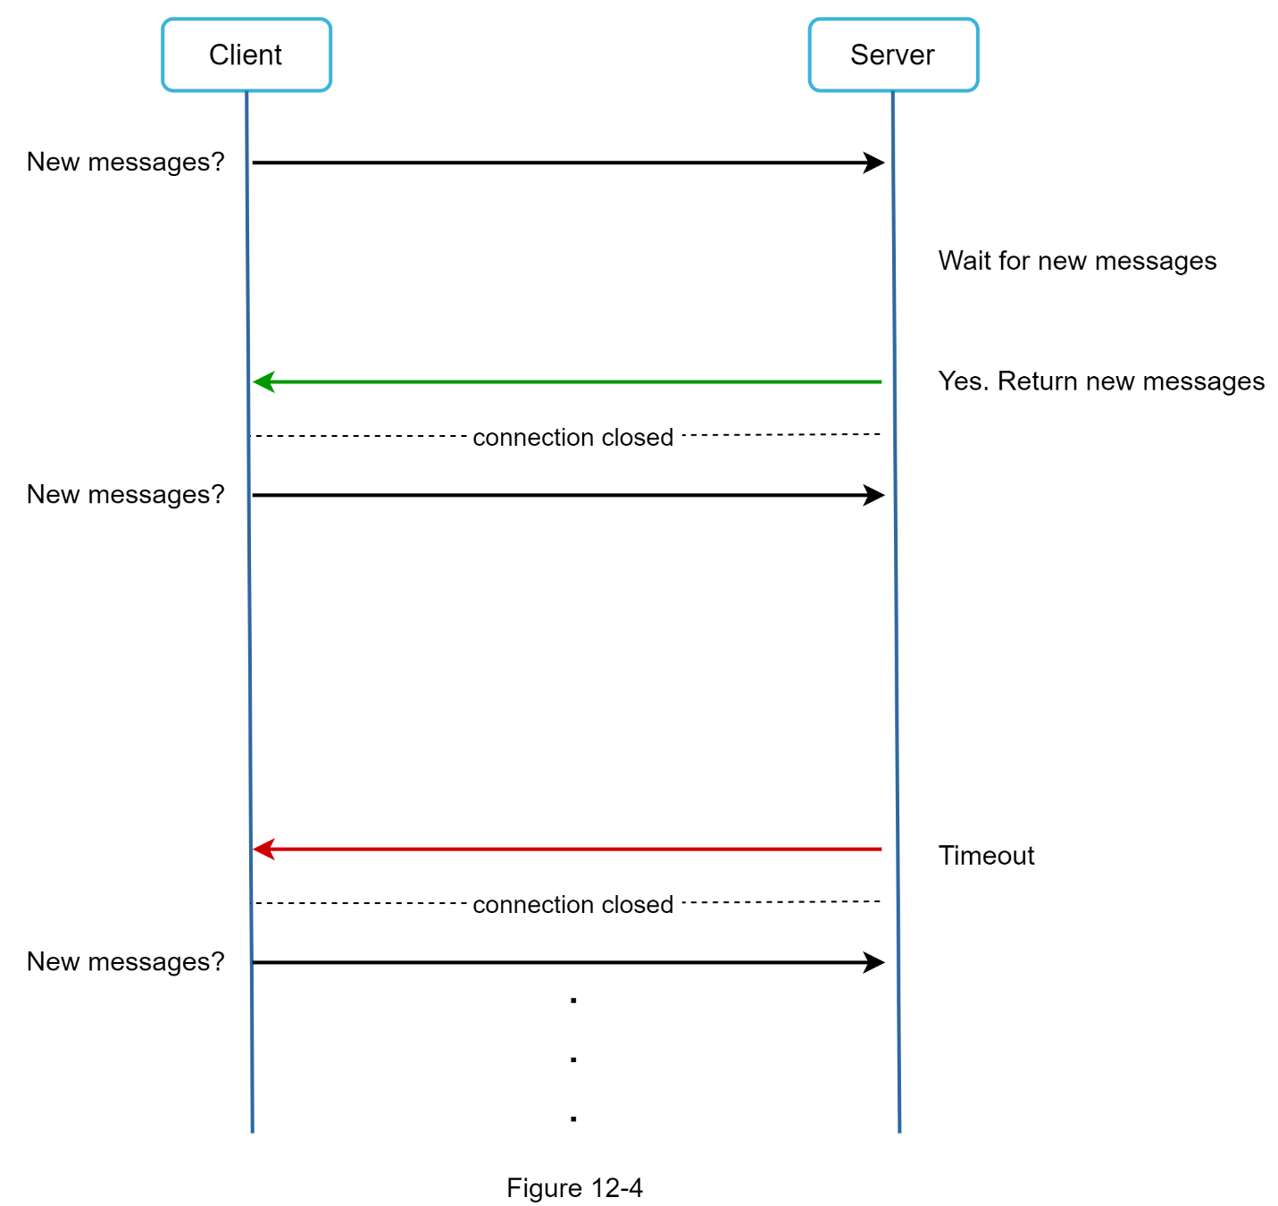
Polling轮询

Slide 5
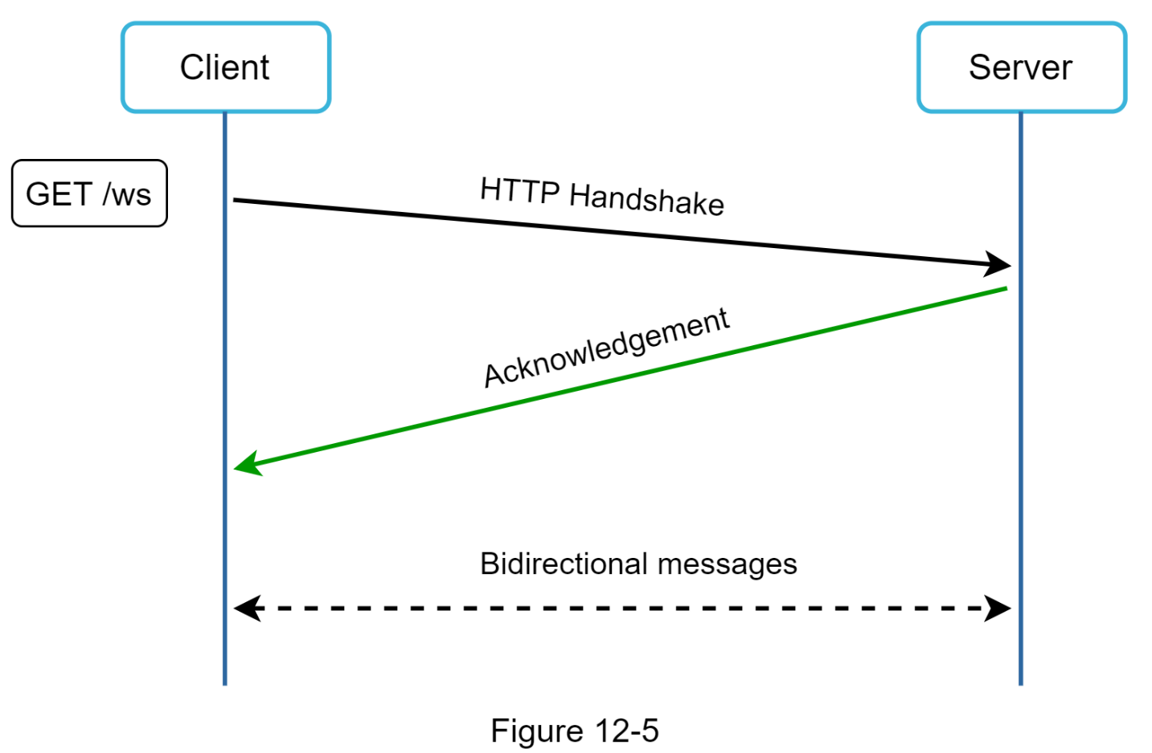
WebSocket

Slide 6
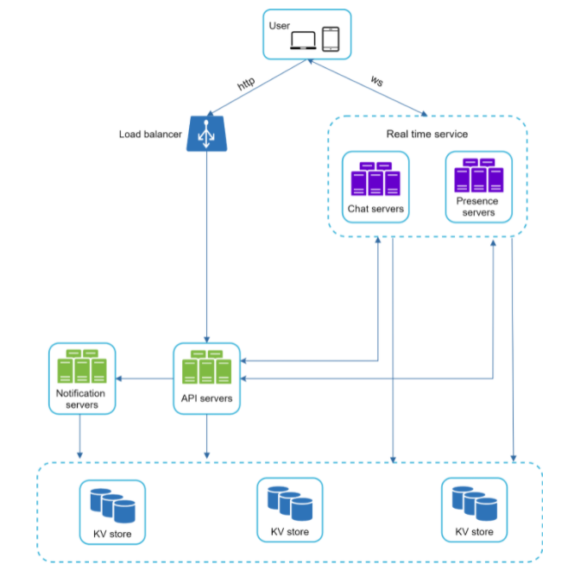
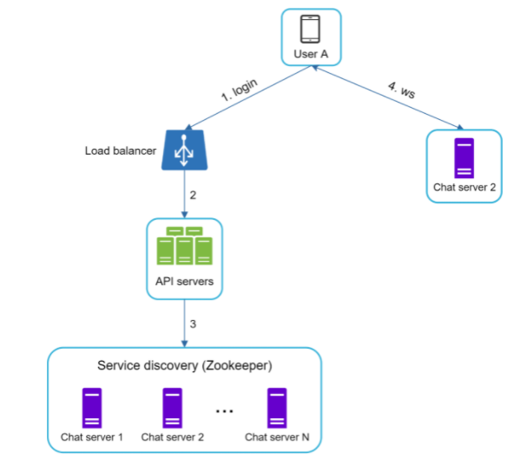
Services
Stateless: login, signup, user profile, etc.
Stateful: chat

Slide 7
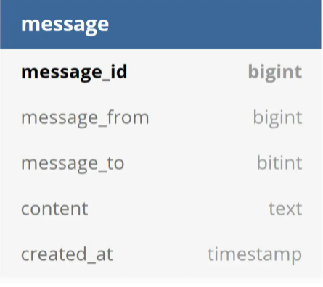
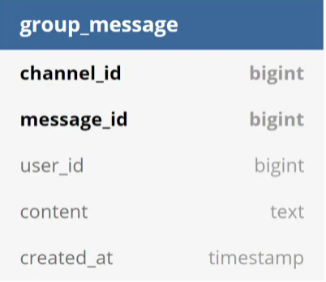
DB schema
1:1 chat
Group chat

Slide 8
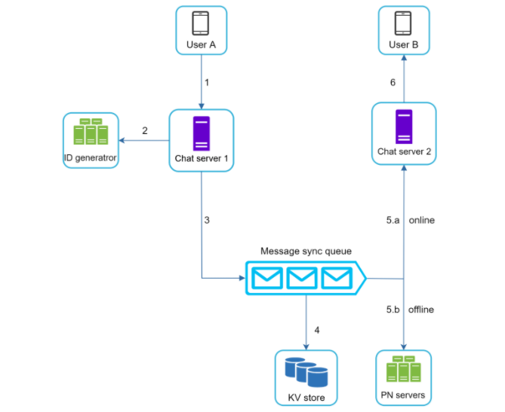
1:1 Message Flow

Slide 9
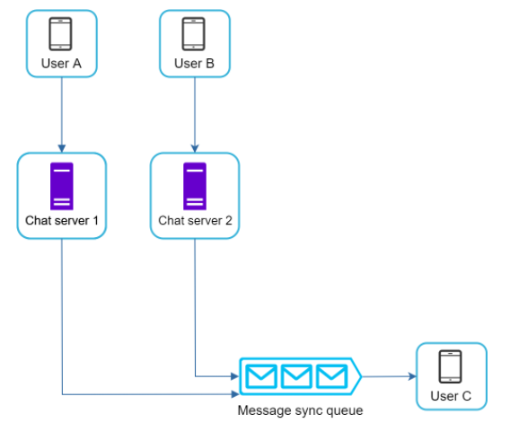
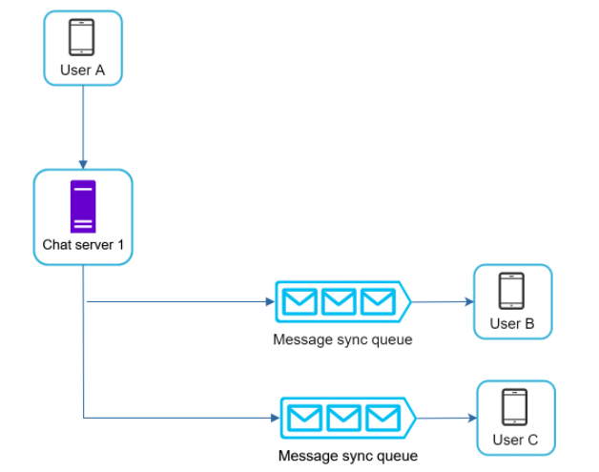
Group Message Flow

Slide 10
Example

